Slide 1
js
JavaScript

Slide 2
“Hello, World!” Program in Browser Console
<html>
<head></head>
<body>
<h1>Check the console for the message!</h1>
<script>
// This is our first JavaScript program
console.log("Hello, World!");
</script>
</body>
</html>

Slide 3
“Hello, World!” Program in Browser Console
The<script> tag is used to include JavaScript code inside an HTML document.
console.log(): The console.log() method is used to print messages to the browser’s developer console. Open the console (usually with F12 or Ctrl + Shift + J) to see the message “Hello, World!” displayed

Slide 4
Comments in the Code
Multi-line Comment: The /* */ syntax is used to write a comment spanning multiple lines.
Single-line Comment: The // syntax is used for short, inline comments, like the one explaining the console.log function.

Slide 5
Variables and Datatypes in JavaScript
A variable is like a container that holds data that can be reused or updated later in the program. In JavaScript, variables are declared using the keywords var, let, or const.
1 var Keyword
The var keyword is used to declare a variable.
var n = 5;
console.log(n);
var n = 20; // reassigning is allowed
console.log(n);

Slide 6
Variables and Datatypes in JavaScript
2. let Keyword
let n= 10;
n = 20; // Value can be updated
// let n = 15; //can not redeclare
console.log(n)

Slide 7
Variables and Datatypes in JavaScript
3 const Keyword
The const keyword declares variables that cannot be reassigned. It’s block- scoped as well.
const n = 100;
// n = 200; This will throw an error
console.log(n)

Slide 8
operaters in javascript
Operatores are a symbol that tell computer to perform some operation on values and variables
Arithmetic operator
Assignment operator
Logical operator
Ternary operator
Comparision operator

Slide 9
dialogue boxes in javascript
A dialogue box (or dialog box) is a small window that appears on top of a webpage or application interface to:
There are three main types of built-in dialogue boxes used to interact with the user:
alert()
Displays a simple message to the user with an OK button.
alert("This is an alert box!");

Slide 10
dialogue boxes in javascript
2. confirm()
Displays a message with OK and Cancel buttons, and returns true if OK is pressed, or false if Cancel is pressed.
let result = confirm("Are you sure you want to delete this?");
if (result) {
console.log("User pressed OK");
} else {
console.log("User pressed Cancel");
}

Slide 11
dialogue boxes in javascript
3. prompt()
Displays a dialog box that prompts the user for input and returns the entered value (as a string), or null if the user presses Cancel.
let name = prompt("What is your name?");
if (name !== null) {
console.log("Hello, " + name);
} else {
console.log("User cancelled the prompt");
}

Slide 12
JavaScript Functions
A fuction is a block of code that perform a specific task.
you can write the code once and use it many times by calling the function
Syntax
Function function_name{
//statements
}

Slide 13
JavaScript Functions
function introduceMe() { document.write("Hi, <br>");
document.write("I am Tuba <br>");
document.write("I am a web developer <br><br>");
}
introduceMe();

Slide 14
function with parameter
function greet(name) {
document.write("Hello, " + name + "!" + "<br>");
} greet(“Zara"); // Output: Hello, Zara!

Slide 15
function with return value:
function add(a, b) {
return a + b;
}
let result = add(5, 3); // result = 8
console.log(result); // Output: 8

Slide 16
FUNCTION TASK:
Task 1: Create a function called welcomeMessage that prints:"Welcome to JavaScript!“
Task 2: Create a function called addNumbers that takes two numbers as parameters, adds them, and prints the result.
Task 3: Create a function called multiply that takes two numbers and returns their product. Store the result in a variable and print it.
Task 4: Create a function called greetUser that takes a name as a parameter and prints a greeting like:"Hello, Ayesha!"

Slide 17
Events in javascript
The change in the state of an object is known as an event
Mouse Event(click,double click, right click, mouseenter,mouseleave)
Keyboard events(keypress,keyup,keydown )
Window events(onscroll,onresize,onload)
Form evet(onsubmit)

Slide 18
Dom in javascript
DOM : stands for Document Object Model
It’s a programming interface for HTML document, it represents the page as a tree structure,allowing you to access and manipulate its content,structure and style.
Each element in the html document is a node in the tree.

Slide 19
DOM TARGETTING METHODS:
Id (document.getElementById(id))
Class Name (document.getElementsByClassName(name))
Tag name (document.getElementByTagname(name)

Slide 20
What we can get with Dom
DOM get methods
HTML
Text
Attribute
innerText
innerHTML
getAttribute
getAttributeNode
Attributes

Slide 21
DOM query selector and query selector all
querySelector and querySelectorAll are methods used to select HTML elements from the DOM (Document Object Model)
document.querySelector()
Returns the first matching element.
Returns null if no match is found.
2. document.querySelectorAll()
Returns a NodeList of all matching elements.

Slide 22
DOM css styling methods:
Style
className
classList

Slide 23
Mouse Events Used:
onclick – triggered by a single click.
ondblclick – triggered by a double click.
oncontextmenu – triggered by right-click.
onmouseenter – when the mouse enters the element.
onmouseleave – when the mouse leaves the element.
onmousemove – while the mouse moves over the element.
onmousedown – when the mouse button is pressed down.
onmouseup – when the mouse button is released.
file:///C:/html%20projectss/Javascript/mouseEvents.html

Slide 24
Data type
PRIMITIVE DATATYPE:
Primitive datatypes represent single values and are immutable
We can classify primitive data types in 7 categories.
Number
String
Boolean
Undefined
Null
Bigint
symbol

Slide 25
Data type
Non-Primitive Datatypes
Non-primitive types are objects and can store collections of data or
more complex entities
We can classify primitive data types in 7 categories.
Number
String
Boolean
Undefined
Null (let empty = null;)
Bigint (let bigNumber = 123456789012345678901234567890n;)
Symbol (let sym = Symbol('unique');)

Slide 26
Data type
There is only one type of non-primitive data type that is called object
Object are further divided into three categories
object literals
Array
Function

Slide 27
JavaScript Object Literal
An object literal is a list of name:value pairs inside curly braces {}.
{firstName:"John", lastName:"Doe", age:50, eyeColor:"blue"}
name:value pairs are also called key:value pairs.

Slide 28
Creating a JavaScript Object
const user = { firstName : “Ali", lastName : “Rehman",
age : 22,
city : “Hyderabad”
}
Console.log(user);
Console.log(user.lastName) //Rehman
document.write(user.firstname) //Ali

Slide 29
Modify and delete value of object
const user = { firstName : “Ali", lastName : “Rehman",
age : 22,
city : “Hyderabad”
};
User.firstName = “Usman”;
delete user.age;
Console.log(user);
Console.log(user.lastName) //Rehman
document.write(user.firstname) //Ali

Slide 30
Creating a JavaScript Object
const user = { firstName : “Ali", lastName : “Rehman",
age : 22,
city : “Hyderabad”,
favGames: [‘badminton’,’card games’,’ludo’,’carom’]
}
Console.log(user.favGames);
Console.log(user.favGames[2]);

Slide 31
Creating a JavaScript Object
const user = { firstName : “Ali", lastName : “Rehman",
age : 22
};
Console.log(user.email ); //undefined
Console.log(‘email’ in user); //false
Console.log(‘age’ in user); //True

Slide 32
Creating a JavaScript Object
const user = { firstName : “Ali", lastName : “Rehman",
age : 22,
city : “Hyderabad”,
favGames: [‘badminton’,’card games’,’ludo’,’carom’],
salary : function(){
return 3000;
}
}
Console.log(user.salary());

Slide 33
Creating a JavaScript Object
const user = { firstName : “Ali", lastName : “Rehman",
age : 22,
city : “Hyderabad”,
favGames: [‘badminton’,’card games’,’ludo’,’carom’],
fullname : function(){
return this.firstName +” “ +this.lastName;
}
}
Console.log(user.fullname());

Slide 34
Print all properties with value
const user = { firstName : “Ali", lastName : “Rehman",
age : 22
};
For(let key in user){
Console.log(key +”: “ +person[key]);
};

Slide 35
Form validation in javascript
Form validation in JavaScript is the process of checking
user input in an HTML form before the data is sent to the server.
This helps ensure that the submitted data is complete
and in the correct format.

Slide 36
Form validation in javascript
<script>
function formData() {
let a = document.getElementById("n1").value.trim();
let b = document.getElementById("n2").value.trim();
if (a === "" || b === "") {
alert("All fields are mandatory");
return false; // form will not submit
}
return true; // form submit
}
</script>
<form onsubmit="return formData()">
Username : <input type="text" id="n1"><br><br>
Password: <input type="password"id="n2"><br><br>
<input type="submit" value="Login">
</form>

Slide 37
Form validation in javascript
Key Points:
onsubmit="return formData()" checks whether the function returns true or false.
If it returns false, the form will not be submitted.
.trim() is used to remove extra spaces so that inputs with only spaces are also considered empty.

Slide 38
After submitted data
<body>
<h1>Your data has been submitted</h1>
</body>
<form action = “dataSubmit.html”>
</form>

Slide 39
Set timeout and set interval
settime out allow us to run a function once after the interval of time.
Syntax:
Let timerId = setTimeout (function , <dealy> , <arg1> , <arg2>)
clearTimeout isused to cancel the execution
Let timerId = setTimeout(() => alert(“never”),1000);
clearTimeout(timerId) //cancel the execution

Slide 40
Set timeout and set interval
setInterval method has a similar syntax as settimeout.
Let timerId = setTimeout(() => alert(“never”),1000);
All arguments have the same meaning,but unlike setTimeout,it runs the function not only once,but regularly after the given interval of time
To stop further calls , we can use clearInterval(timerId)

Slide 41
Javascript Async(asynchronous)
Synchronous:
Synchronous means the code runs in a particular sequence of instructions given in a program.
Asynchronous:
Asynchronous action are the actions that we initiate now and they finish later
Eg. setTimeout

Slide 42
Example of synchronous programming
let a = prompt("What is your name : ");
let b = prompt("what is your age : ");
let c = prompt("What is your favourite color : ");
console.log(a +" is " +b +" Years old " +c +" favourite color.");

Slide 43
Example of Asynchronous programming
Ex – 1:
function hello(){
console.log("Hello Everyone");
}
setTimeout(hello , 2000);

Slide 44
Example of Asynchronous programming
Ex – 2:
setTimeout(() => {
console.log("Hello Everyone");
}, 2000);

Slide 45
Example of Asynchronous programming
Ex – 3:
Console.log(“start");
setTimeout(function(){
alert(“HELLO EVERYONE ! ")
},5000)
Console.log(end);

Slide 46
Callback function
A callback function is a function passed into
another function as an argument,which is then invoked inside the outer function to complete an action.
Here is an example of callback.

Slide 47
Callback hell
Nested callbacks stacked below one another forming a pyramid structure.
(Pyramidof doom)
This style of programming becomes difficult to understand & manage.
The solution to the callback hell is promises.

Slide 48
Promises
A promise is a “promise of code execution”.
The code either execute or fails , in both the cases the subscriber will be notified.
The syntax of a promise looks like this,
Let promise = new promise (function(resolve,reject){
//execute
});

Slide 49
Promises
Promise is for “eventual” completion of task. It is an object in JS.
It is a solution to callback hell.
let promise = new Promise( (resolve, reject) => { .... } )
Function with 2 handlers
*resolve & reject are two callbacks provided by JS itself.they are called like this
Resolve(value) → if the job is finished successfully
Reject(value) → if the job

Slide 50
Promises
A JavaScript Promise object can be:
Pending : the result is undefined
Resolved : the result is a value (fulfilled) resolve( result )
Rejected : the result is an error object reject( error )
*Promise has state (pending, fulfilled) & some
result (result for resolve & error for reject).

Slide 51
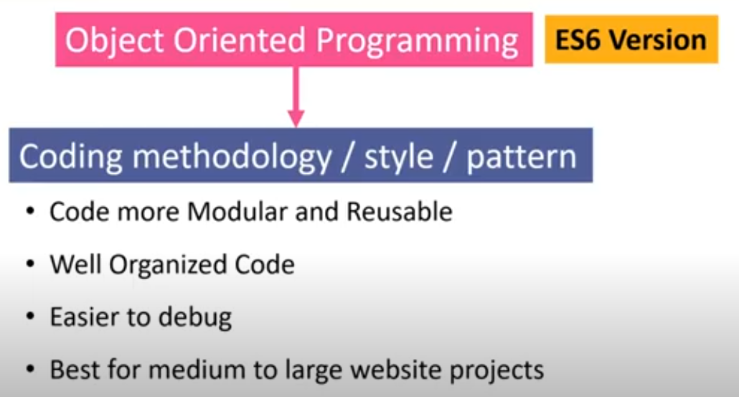
Advance javascript oop introduction

Slide 52
OOPs Concept in Javascript
Object | Classes | Encapsulation
Abstraction | Inheritance | Polymorphism

Slide 53
object
An Object is a unique entity that contains properties and methods.
JS object have a special property called prototype.
const student = {
fullName : "Ali",
marks : 70,
printMarks : function(){
console.log("marks = " , this.marks); //student.marks
}
};
console.log(student);

Slide 54
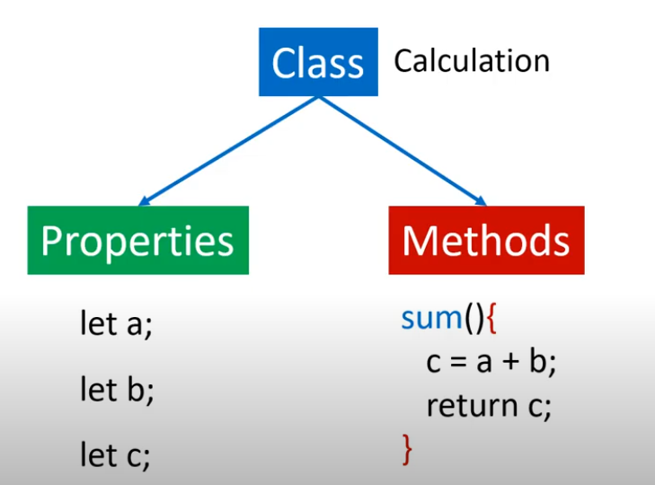
What is properties and method

Slide 55
Way to create method in onject
const student = {
fullName : "Ali",
marks : 70,
printMarks(){
console.log("marks = " , this.marks);
}
};
console.log(student);

Slide 56
OOPs Concept in JavaScript
There are two primary ways to create an object in JavaScript: Object Literal and Object Constructor.
1. Creation Using Object Literal
The object literal syntax allows you to define and initialize an object with curly braces {}, setting properties as key-value pairs.
let obj = {
name: "Sourav",
age: 23,
job: "Developer"
};
console.log(obj);

Slide 57
2. Creation Using new Object() Constructor
let obj = new Object();
obj.name= "Sourav",
obj.age= 23,
obj.job= "Developer"
console.log(obj);

Slide 58
Basic Operations on JavaScript Objects
1. Accessing Object Properties
You can access an object’s properties using either dot notation or bracket notation
let obj = { name: "Sourav", age: 23 };
// Using Dot Notation
console.log(obj.name);
// Using Bracket Notation
console.log(obj["age"]);

Slide 59
Creating Bank Accounts Using a Constructor Function in JavaScript
function BankAccount(customerName , balance = 0){
this.customerName = customerName;
this.accountNumber = Date.now();
this.balance = balance;
}
const aliAccount = new BankAccount("Ali" , 4000);
const usmanAccount = new BankAccount("Usman" , 6000);
const rehmanAccount = new BankAccount("Rehman" , 7000);
const bilalAccount = new BankAccount("Bilal");
console.log(aliAccount,usmanAccount,rehmanAccount,bilalAccount);
console.log(aliAccount.accountNumber);

Slide 60
Creating Bank Accounts Using a Constructor Function in JavaScript
function BankAccount(customerName , balance = 0){
this.customerName = customerName;
this.accountNumber = Date.now();
this.balance = balance;
this.deposit = function(amount){
this.balance += amount
}
}
const aliAccount = new BankAccount("Ali" , 4000);
aliAccount.deposit(3000);
console.log(aliAccount);

Slide 61
Creating Bank Accounts Using a Constructor Function in JavaScript
function BankAccount(customerName , balance = 0){
this.customerName = customerName;
this.accountNumber = Date.now();
this.balance = balance;
this.deposit = function(amount){
this.balance += amount
};
this.withdraw = (amount) =>{
this.balance -= amount;
}
}
const aliAccount = new BankAccount("Ali" , 4000);
aliAccount.deposit(3000);
aliAccount.withdraw(2000);
console.log(aliAccount);

Slide 62
Classes
Classes are blueprints of an Object. A class can have many Objects because the class is a template while Objects are instances of the class or the concrete implementation.
Ex:
class hello{
message(){
console.log("Hello Everyone !")
}
};
let a = new hello();
a.message();

Slide 63
Types of method
Constructor (Automatically call)
Eg: constructor(){
Console.log(“hello”)}
2. Prototype (not call Automatically)
Ex: message(){
console.log("Hello Everyone !")
}
Static
static name(){
console.log("Hello")
}

Slide 64
what is inheritance(Code Reusability)
Inheritance means one class can reuse the properties and methods of another class.
This is done using the extends keyword.
Benefit? → Code gets reused and adding new features becomes easier.

Slide 65
what is inheritance(Code Reusability)
// Parent class
class Animal {
makeSound() {
console.log("Animal makes a sound");
}
}
// Child class (inherits from Animal)
class Dog extends Animal {
bark() {
console.log("Dog barks");
}
}
// Using the classes
const d = new Dog();
d.makeSound(); // Inherited method
d.bark(); // Child class specific method

Slide 66
what is Encapsulation (Data Hiding)
Encapsulation means protecting the data inside a class and restricting direct access to it. This is done using private variables and getter/setter methods.

Slide 67
what is Polymorphism (One Interface, Many Forms)
Polymorphism means a method or function can behave in multiple ways. There are two types:
Compile-time Polymorphism (Method Overloading)
Runtime Polymorphism (Method Overriding)

Slide 68
what is Polymorphism (One Interface, Many Forms)
Polymorphism means a method or function can behave in multiple ways. There are two types:
Compile-time Polymorphism (Method Overloading)
Runtime Polymorphism (Method Overriding)

